Slide 1
Introduction to Convolutional Neural Network
Presented by:
Abhishek Tadkod 2GI17CS002
Cheryl D’souza 2GI17CS030
Chetana Bhat 2GI17CS031
K S Chitra 2GI17CS047

Slide 2
Definition
A convolutional neural network (CNN) is a specific type of artificial neural network that uses a machine learning unit algorithm, for supervised learning, to analyze data. CNNs apply to image processing, natural language processing and other kinds of cognitive tasks.

Slide 3
Classical Image Classification
In the past, image classification models used raw pixels to classify the images.
For example You can classify cats by color histogram and edge detection which allows you to classify cats by color and ear shape. This method has been successful but until the method encounters more complex variants.
That’s where the classical image recognition fails because the model does not account for other features. To overcome this problem CNN was used.

Slide 4
Convolutional Neural Networks
CNN is a type of neural network model which allows us to extract higher representations for the image content. Unlike the classical image recognition where you define the image features yourself, CNN takes the image’s raw pixel data, trains the model, then extracts the features automatically for better classification.

Slide 5
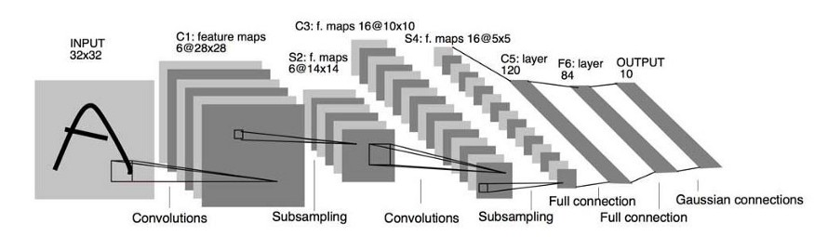

Slide 6
Principles of CNN
Convolution
A convolution sweeps the window through images then calculates its input and filter dot product pixel values. This allows convolution to emphasize the relevant features.

Slide 7
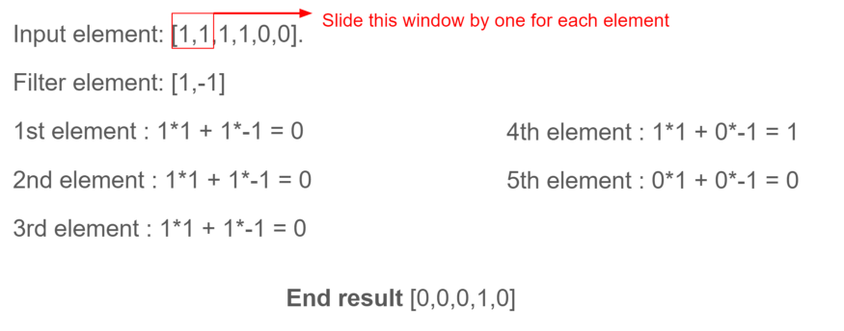
1D Convolution Operation
Here We will encase the window elements with a small window, dot multiplies it with the filter elements, and save the output. We will repeat each operation to derive 5 output elements as [0,0,0,1,0]. From this output, we can know that the feature change(1 becomes 0) in sequence 4. The filter has done well to identify the input values. Similarly, this happened for 2D Convolutions as well.

Slide 8
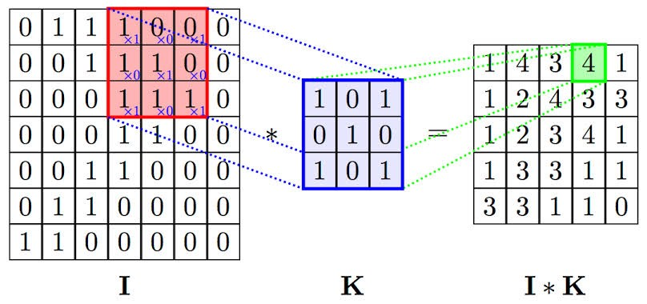
2D Convolutions Operation
With this computation, we can detect a particular feature from the input image and produce feature maps (convolved features) which emphasizes the important features. These convolved features will always change depending on the filter values affected by the gradient descent to minimize prediction loss.

Slide 9
Convolutional kernels
Each convolutional layer contains a series of filters known as convolutional kernels.
The filter is a matrix of integers that are used on a subset of the input pixel values, the same size as the kernel.
Each pixel is multiplied by the corresponding value in the kernel, then the result is summed up for a single value for simplicity representing a grid cell, like a pixel, in the output channel/feature map.

Slide 10
The input is often a 3 channel RGB image.
For simplicity, if we take a grey scale image that has one channel (a two dimensional matrix) and a 3x3 convolutional kernel (a two dimensional matrix). The kernel strides over the input matrix of numbers moving horizontally column by column, sliding/scanning over the first rows in the matrix containing the images pixel values.
Then the kernel strides down vertically to subsequent rows. Note, the filter may stride over one or several pixels at a time

Slide 11
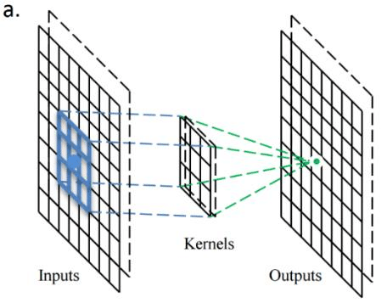
diagram showing the operation of the convolutional kernel.

Slide 12
Padding
To handle the edge pixels there are several approaches:
Losing the edge pixels
Padding with zero value pixels
Reflection padding

Slide 13
Reflection padding is by far the best approach.
Here the number of pixels needed for the convolutional kernel to process the edge pixels are added onto the outside copying the pixels from the edge of the image.
For a 3x3 kernel, one pixel needs to be added around the outside, for a 7x7 kernel then three pixels would be reflected around the outside. The pixels added around each side is the dimension, halved and rounded down.

Slide 14
Many kernels
In CNN models there are often there are many more than three convolutional kernels, 16 kernels or even 64 kernels in a convolutional layer is common.
These different convolution kernels each act as a different filter creating a channel/feature map representing something different.
For example, kernels could be filtering top edges, bottom edges, diagonal lines and so on.

Slide 15
Common uses for CNNs
The most common use for CNNs is image classification, for example identifying satellite images that contain roads or classifying hand written letters and digits. There are other quite mainstream tasks such as image segmentation and signal processing, for which CNNs perform well at.
CNNs have been used for understanding in Natural Language Processing (NLP) and speech recognition.

Slide 16
Advantages and disadvantages
Advantages
Accuracy in image recognition problems.
Has high statistical efficiency.
Has high computational efficiency.
Disadvantages:
High computational cost.
If we don't have a good GPU they are quite slow to train (for complex tasks).
They use to need a lot of training data.

